Slide 1
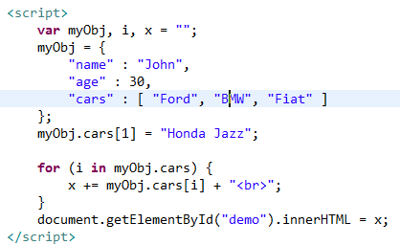
JSON Arrays
We can use the index number to modify an array

